Slide 1
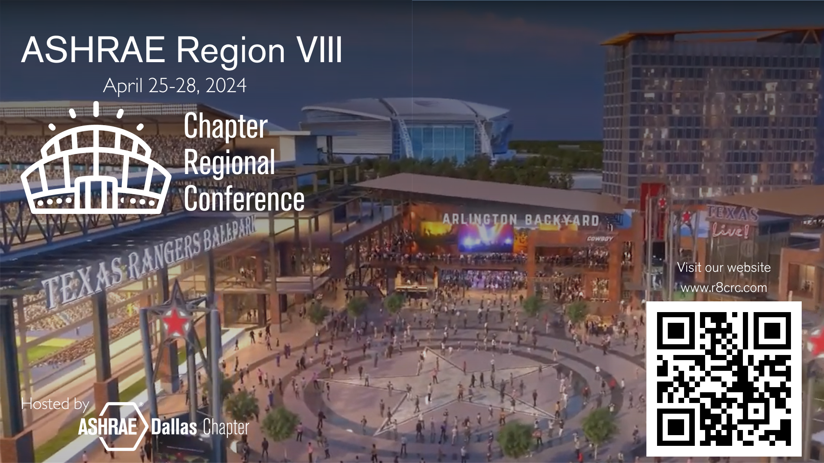

Slide 2
REGISTER NOW!
What: Region Business & Training
When: April 25-28, 2024
Where: Arlington, TX
How: R8CRC.com
Notes:
When you’re looking for the most exciting dining and entertainment in the Dallas–Fort Worth Metroplex, you’ll find yourself at Texas Live!, the recreation hub nestled among the Dallas Cowboys’ AT&T Stadium, the Texas Rangers’ Globe Life Field, and the Esports Stadium & Expo Center. Staying at Live! by Loews – Arlington puts you at the center of all the action, with all the benefits of a stylish, modern retreat.

Slide 3
Who should attend CRC?
Chapter Delegates and Alternates
Current year (2023-2024) Chapter Volunteers
Future year (2024-2025) Chapter Volunteers
💡Consider framing CRC as a Chapter Board Retreat.
Notes:
When you’re looking for the most exciting dining and entertainment in the Dallas–Fort Worth Metroplex, you’ll find yourself at Texas Live!, the recreation hub nestled among the Dallas Cowboys’ AT&T Stadium, the Texas Rangers’ Globe Life Field, and the Esports Stadium & Expo Center. Staying at Live! by Loews – Arlington puts you at the center of all the action, with all the benefits of a stylish, modern retreat.

Slide 4
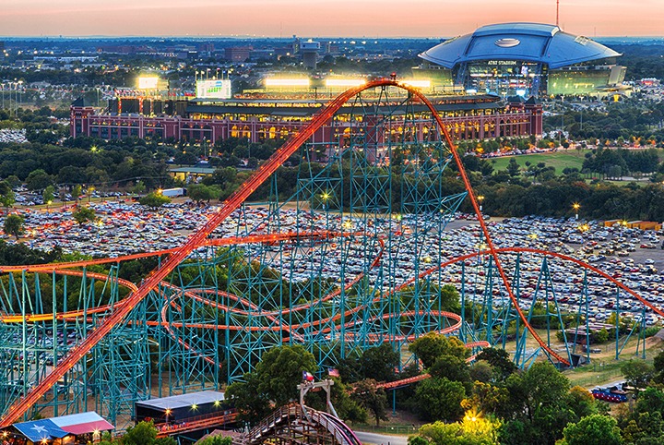
Arlington Entertainment District
Dallas Cowboys’ AT&T Stadium
Texas Rangers’ Globe Life Field
Texas Live! – restaurants, cocktail bars, and more
Arlington Backyard - outdoor live music venue
Esports Stadium
Six Flags Over Texas
Six Flags Hurricane Harbor
Notes:
Within a short walk or drive….

Slide 5
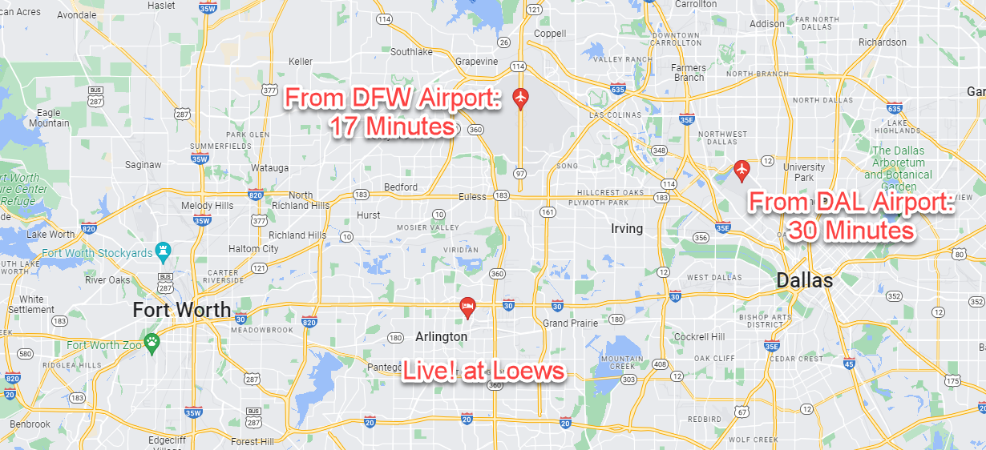
Location: Arlington, TX
Notes:
Our CRC will take place in Arlington, Texas. It is conveniently located between Dallas and Fort Worth. It is a 17 minute drive from DFW and a 30 minute drive from DAL (Love-Field).

Slide 6
Pre-Conference Agenda/Timeline
March 31, 2024 – CRC Hotel Block CLOSES
April 11, 2024 – CRC Registration CLOSES – No On-site Registration
April 11, 2024 - Caucus Orientation - VIRTUAL
April 18-19, 2024 - Chapter Chair Training – VIRTUAL (more details in next slides)
April 25-28, 2024 - Chapter Regional Conference (CRC) - IN PERSON (more details in next slides)

Slide 7
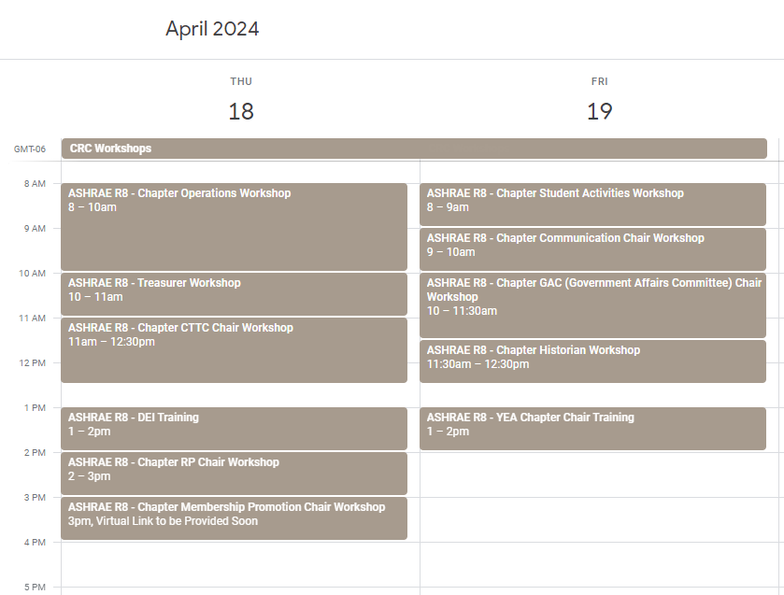
April 18-19, 2024 - Chapter Chair Training
Chapter Chairs should attend BOTH virtual training and in-person workshop at CRC.
Virtual Workshop – meet RVC + learn functional portions of role.
In-person Workshop – collaborate on ideas, learn best practices, create plan for the year.
23-24 R8 Golden Gavel Committee Awards
Chapters will earn points for 2023-2024 Golden Gavel and Chapparal awards by attending the in-person Leadership Workshop at CRC in Dallas.
24-25 PAOE
Chapters earn 2024-2025 PAOE points for "Attend CRC Workshop" if the correct person attends the virtual workshop.
Chapters can earn 2024-2025 PAOE points for "Planning/Goal Setting Session" by attending the in-person Leadership Workshop at CRC in Dallas.
Register: https://www.r8crc.com/chapter-chair-workshops

Slide 9
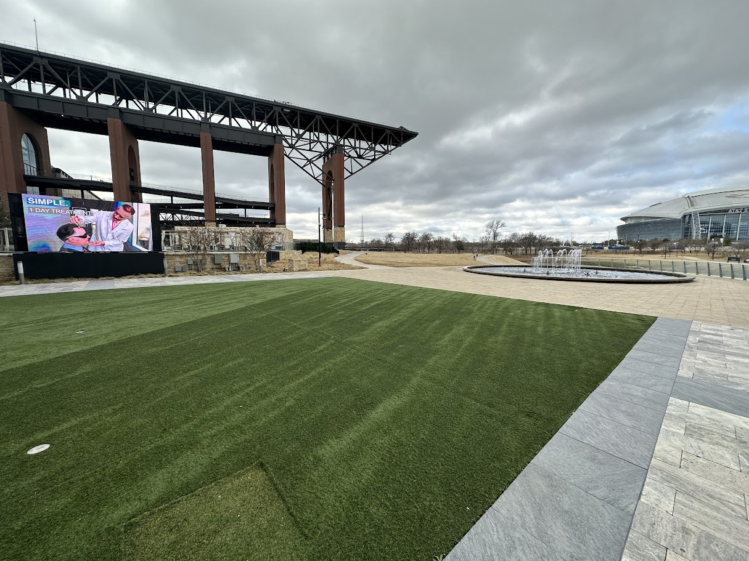
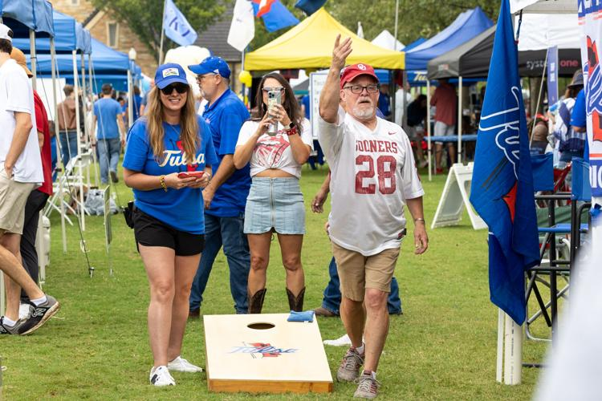
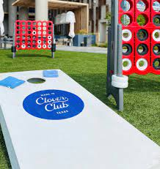
Tailgate Reception - support for your favorite sports team with a polo, jersey, or t-shirt.

Slide 10
Golden Gavel Gala – Wear Gold!

Slide 11
Conference Agenda
Thursday April 25
FRIDAY APRIL 26
SATURDAY APRIL 27
Social & Sightseeing Activities
Golf
Sightseeing on your own!
Globe Life Field
Dallas Cowboys AT&T Stadium Tour
Six Flags Over Texas
Texas Rangers Game
Learning & Meetings
Morning: Dallas ASHRAE Engineering Expo
Caucus 1
Lunch: CRC Kickoff & Welcome Lunch
Afternoon: Business Session
Happy Hour: Heavy apps & drinks at terrace overlooking AT&T Stadium
Evening: Dinner on your own at Texas Live!
Meetings & Awards Gala
Morning: Business Session
Lunch & Caucus 2
Afternoon: Leadership Forum
Evening: Awards Gala
SUNDAY APRIL 28
Caucus 3 (if needed)
CRC Debrief
Notes:
We have modified our standard CRC schedule, compressing it to allow for only that Friday to be out of the office if you need.

Slide 12
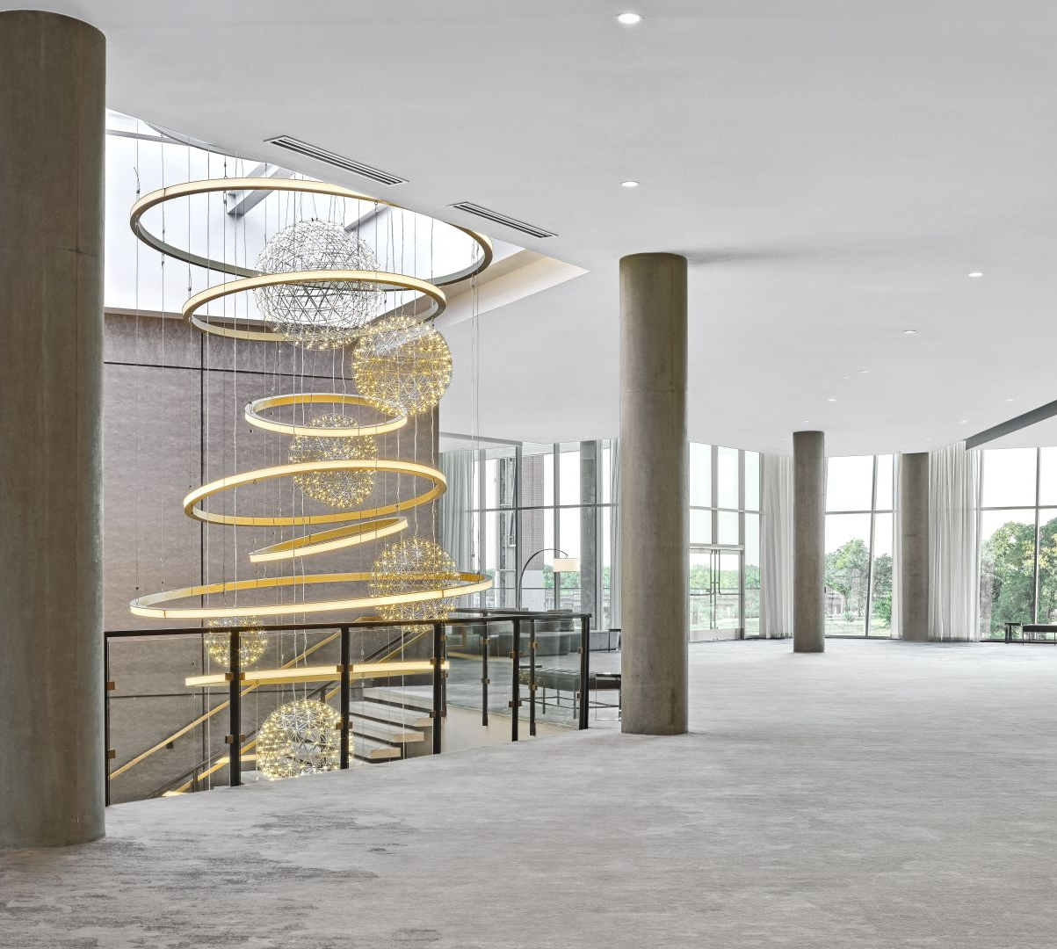
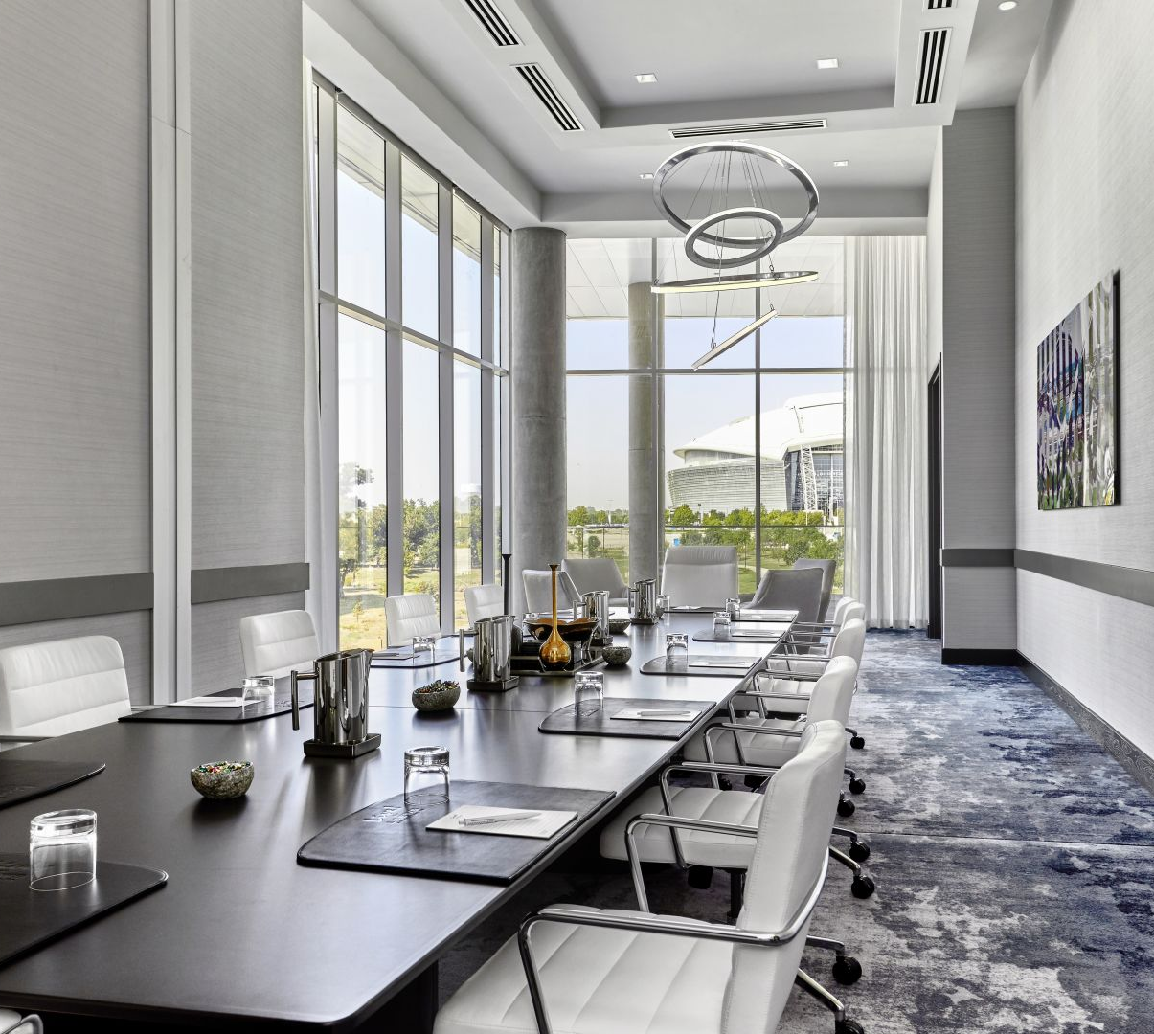
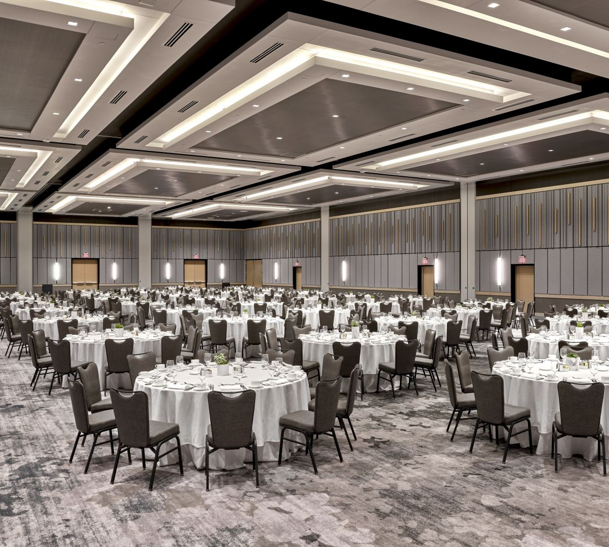
Essential Information
Hotel: Discounted rate of $249/night
Registration: $300
$50 add-on for Engineering Summit
$150 add-on for Golf
Link: www.r8crc.com

Slide 13
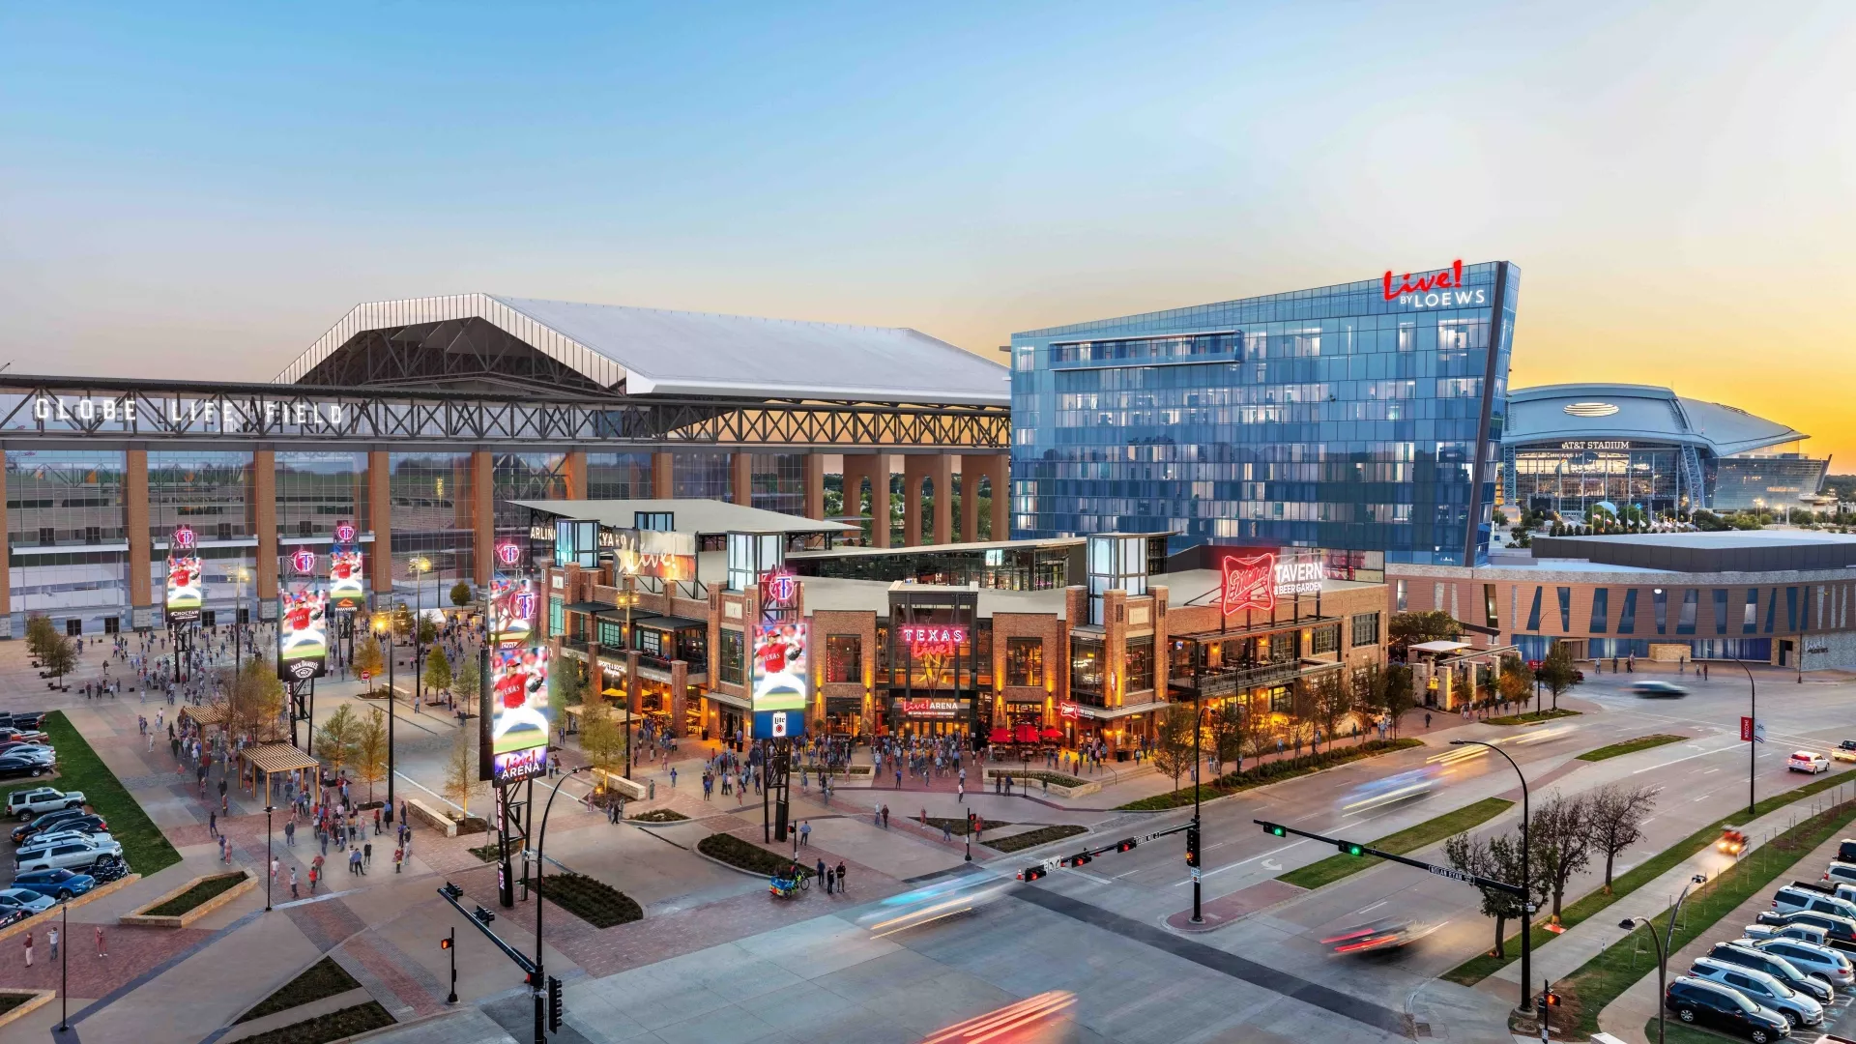
2024 CRC
April 25-28, 2024

Slide 15
Make a weekend of it!

Slide 16
Notes:
https://players.brightcove.net/5159849784001/rUd939qC_default/index.html?videoId=6296984476001

Slide 17
Sneak Peek: Hospitality Suite

Slide 18
Sneak Peek: Hospitality Suite

